Slide 1

Soum* Platform Sales & Reach Out Trend
Mohammed Alsalamah

Slide 2
Executive Summary
Requested Figures
Conversion rate of registered customers
Churn rate after 1st purchase
Largest 3 markets
Average time between registration date and 1st purchase date
Insights and action plan
Marketing
Promotions
Future analysis and next steps

Slide 3
Two datasets enabled us to analyze the platform’s performance
Transactions
ID | Trans. Date | Status | Phone | City | $_Total
00001 | 28-Aug-2025 | Refunded | 05550… | Riyadh | 5,000
00002 | 03-Sep-2025 | Transferred | 05061… | Abha | 2,150
…
Customers
ID | Rgstr. Date | Phone | Last Login
0000001 | 01-Aug-2025 | 05051… | 01-Aug-2025
0000002 | 06-Oct-2025 | 05063… | 02-Nov-2025
…

Slide 4
Less than 2.5% of registered customers make a purchase!
# Find the number of unique users
n_customers = customers.customer_phone.nunique()
# Find the number of customers who made at least one purchase
n_paying_customers = transactions.buyer_phone.nunique()
# Find ratio conversion_rate = n_paying_customers / n_customers

Slide 5
Little over 15%* of customers make a second purchase
# Number of customers who made a at least 1 purchase
n_made_1st_purchase = purchase_df_unique['purchase_1'].count()
# Number of customers who made a 2nd purchase
n_made_2nd_purchase = purchase_df_unique['purchase_2'].count()
# Find ratio
churn_rate = n_made_2nd_purchase / n_made_1st_purchase

Slide 6
Accepting v.s. returning a device doesn’t affect customer churn rate
 | 2nd Purchase Status
1st Purchase Status |  | Accepted | Returned
 | Accepted | 17% | 83%
 | Returned | 17% | 83%
The equal churn rate suggests that customers are satisfied with our refund policy

Slide 7
Customers who recently returned an item are less likely to return the next item they buy (53% vs. 65%)
 |  | 3rd Purchase Status
1st Purchase Status | 2nd Purchase Status | Accepted
Returned | Returned | 65%
 | Accepted | 53%
Accepted | Returned | 69%
 | Accepted | 51%
+12%
+18%
Must focus marketing on customers who are still looking for a device!

Slide 8

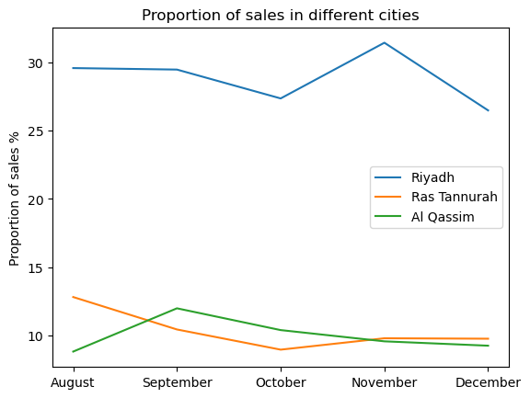
Riyadh, Al Qassim, and Ras Tannurah make up 45% of total sales
Sales are not concentrated in neither large nor small cities

Slide 9
On average, customers take two months* to make a purchase after registeration
# Filter out purchases other than the first purchase
first_purchase_df = transactions.loc[~ transactions.duplicated(subset="buyer_phone", keep='first')]
# Join transactions with customers dataframes
joined_df = first_purchase_df.merge(customers, left_on="buyer_phone", right_on="customer_phone", how="inner", suffixes=['_purchased', '_customer’])
# Calculate average time between registration and purchase
joined_df['time_until_purchase'] = joined_df.date - joined_df.createdDate
# Find mean
avg_delay = joined_df['time_until_purchase'].mean()

Slide 10
Data quality issues exist in dataset; 17% of customers make a purchase before registering!
# Total number of 1st purchases
n_1st_purchase = time_until_purchase_days.count()
# Number of purchases occurring less than a second after registration
n_invalide_entries = (time_until_purchase_days <= 0).sum()
# Find ratio
invalid_ratio = n_invalide_entries / n_1st_purchase

Slide 11
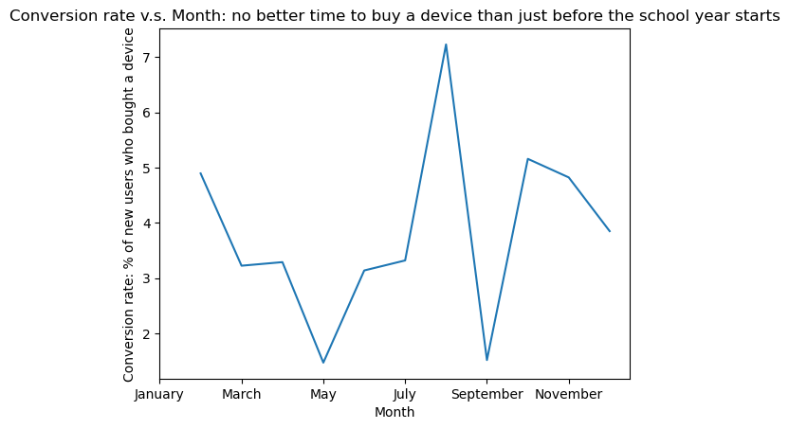
Conversion rate in August is much higher than average conversion rate (7.5% v.s. 2.5%)
Highest conversion rates occur at the beginning of the school year

Slide 12
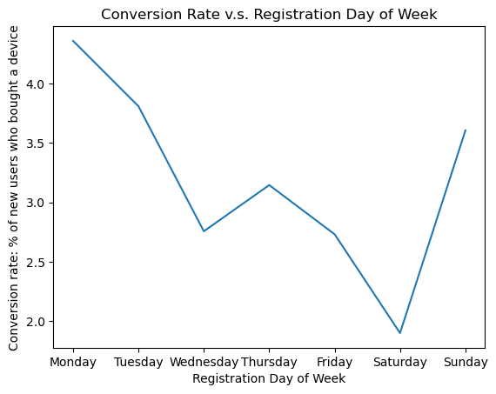
conversion rate is highest on Sundays, Mondays, and Tuesdays (~4% v.s. 2.5%)

Slide 13
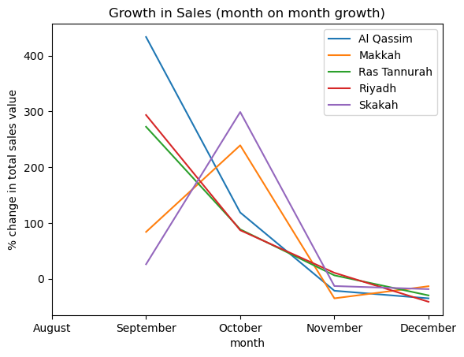
Period of rapid growth has ended!
Two clusters: cities with high growth in October and cities with low growth in October

Slide 14
Insights and Next Steps
Marketing
Concentrate marketing to August and January (7% vs.. 2.5% average conversion rate) (Result 4.4)
Selectively choose to market on Thursday and Friday (4.5% vs.. 2.5% average conversion rate) (Result 4.5)
Promotions
Offer promotions to customers who recently returned an item; they are more likely to keep the next item they purchase (65% vs. 50%) (Result 2.3)
Future analysis and next steps
Perform data validation steps to improve data quality
Further invistigation of some promising trends

